Slide 1


Submitted by: SWETA(201600056) ABHISHEK KUMAR(201600057) MAYUR MAHANTA(201600491) PREETAM KALITA(201600489)
“ ANALYSIS OF GENERAL ELECTION 2019 ”

Slide 2
INTRODUCTION
We live in the data age. It’s not easy to measure the total volume of data stored electronically, but according to an IDC estimate, from 2005 to 2020, the digital universe will grow by a factor of 300, from 130 Exabytes to 40,000 Exabytes, or 40 trillion gigabytes (more than 5,200 gigabytes for every man, woman, and child in 2020).
One of the problems is that most analysis tasks need to be able to combine the data in some way; data read from one disk may need to be combined with the data from any of the other 99 disks. Various distributed systems allow data to be combined from multiple sources, but doing this correctly is notoriously challenging.
Thus, our project is to analyse the big data over the datasets of Indian Elections 2019 using Hadoop, Hive, Impala and Tableau.

Slide 3
OBJECTIVE:
The aim of this project is to analyse the data of General Election 2019 of India. This project will help to know the incumbency of previous government and also the statistics to show the win and loose ratio in desired states.

Slide 4
TECHNOLOGY USED:
HADOOP
HIVE
IMPALA
TABLEAU

Slide 5
DATA DICTIONARY:
State string
Pc string
Candidate string
Party string
evm_vote int
postal_vote int
total_vote double
percent_vote double
Rank int

Slide 6
PROBLEM STATEMENT:
Total number of EVM vote , postal vote and total number of votes casted in General Election.
Print the total number of seat won by all the parties.
Analyse total seat won by parties in state like rajasthan , madhyapradesh,punjab.
Analyse the vote percent of top 5 parties in Uttar Pradesh.
Find out top five candidate having maximum number of vote.
Top 10 parties to elect in maximum number of seats.
Top 10 Win by highest margin.
Top 10 Win by lowest margin.
Top 10 states to cast max number of postal votes.
Top 10 states to cast least number of postal votes.
Find top 10 states where there is least percentage vote shared by Bharatiya Janata Party.
Find top 10 states where there is maximum percentage vote shared by Bharatiya Janata Party.

Slide 7
Coding
$ hive
hive> create database project;
hive> use project;
hive> create table project(state string,pc string,candidate string,party string,evm_vote int,postal_vote int,total_vote double,percent_vote double,rank int)row format delimited fields terminated by ',';
hive>load data local inpath 'Desktop/general_election.csv' into table project;
QUERY 1:: total number of evm_vote , postal vote and total number of votes . Plot a graph.
hive>create table q1 as select SUM(evm_vote) as EVM_VOTE,SUM(postal_vote) as POSTAL_VOTE,SUM(total_vote) as TOTAL_VOTE from project;
Query 2:: Print the total number of seat won by all parties and plot a graph.
hive>create table q2 as select party,count(*) as total_won from project where rank=1 group by party;

Slide 8
Coding
q3::Total win by parties in state like rajasthan, Madhya pradesh, Punjab.
hive> create table q3 as select state,party,count(party) as won from project where rank=1 and state IN ('Rajasthan','Madhya Pradesh','Punjab') group by state,party order by state limit 10;
q4::percentage vote by top 5 parties in Uttar Pradesh. Plot the graph.
hive> create table q4 as select party,avg(percent_vote) as percent_vote from project where state='Uttar Pradesh' group by party order by percent_vote desc limit 5;
q5::Top 5 candidate to have maximum votes. plot a graph
hive>create table q5 as select state,candidate,pc,party,total_vote,rank from project where rank=1 order by total_vote desc limit 5;
q6::Top 10 parties to elect in maximum number of seats. plot
hive>create table q6 as select party,count(*) as x from project group by party order by x desc limit 10;

Slide 9

Input/Output
Q) Total number of EVM vote , postal vote and total number of votes casted in General Election . Plot the graph.
Select SUM(evm_vote) as EVM_VOTE,SUM(postal_vote) as POSTAL_VOTE,SUM(total_vote) as TOTAL_VOTE from project;

Slide 10
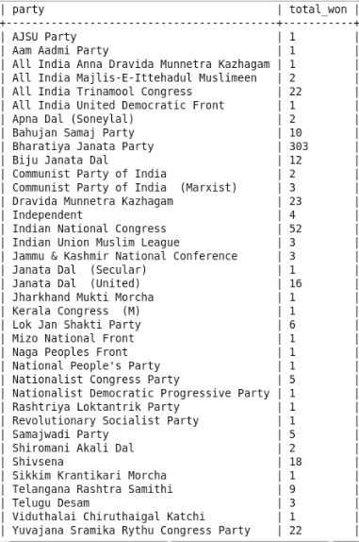
Q) Print the total number of seat won by all the parties.Plot the graph.
select party,count(*) as total_won from
project where rank=1 group by party;

Slide 11
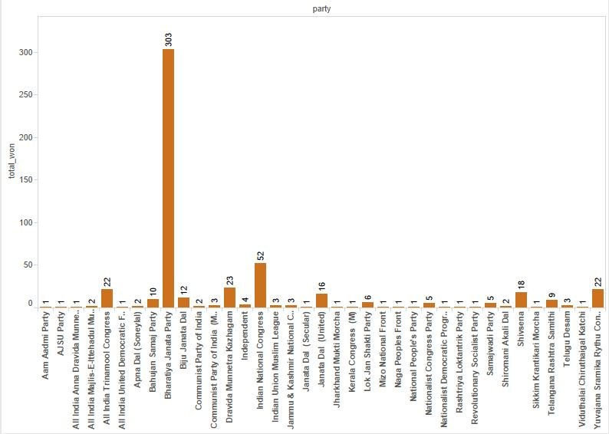

Slide 12
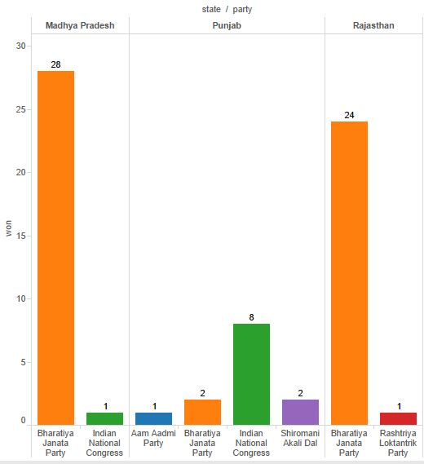
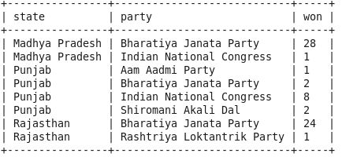
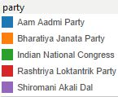
Q) Analyse total seat won by parties in state like Rajasthan , Madhya Pradesh, Punjab
select state,party,count(party) as won
from project where rank=1 and state
IN ('Rajasthan','Madhya Pradesh‘
,'Punjab') group by state,party order
by state limit 10;

Slide 13
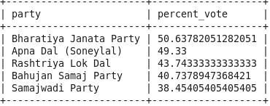
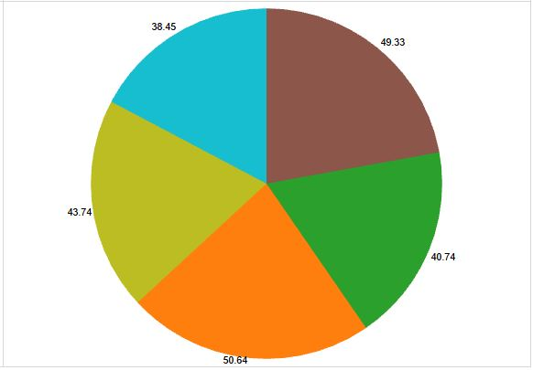
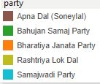
Q)Analyse the vote percent of top 5 parties in Uttar Pradesh
select party,avg(percent_vote) as percent_vote from project where state='Uttar Pradesh' group by party order by percent_vote desc limit 5;

Slide 14
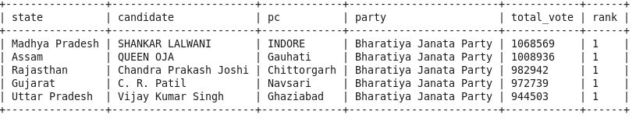
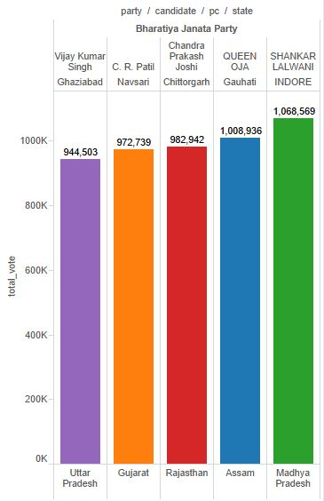
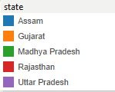
Q)Find out top five candidate having maximum number of vote
select state,candidate,pc,party,total_vote,rank from project where rank=1 order by total_vote desc limit 5;

Slide 15
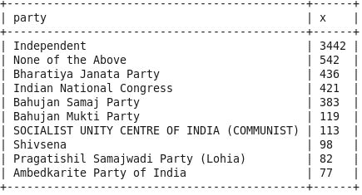
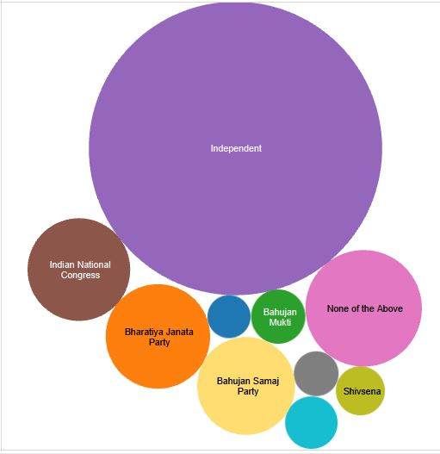
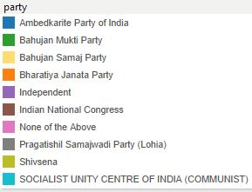
Q)Top 10 parties to elect in maximum number of seats.
select party,count(*) as x from project group by party order by x desc limit 10;

Slide 16
Q)Top 10 Win by highest margin
create table m1 as select state,pc,candidate,total_vote from project where rank=1 order by state;
create table m2 as select state,pc,candidate,total_vote from project where rank=2 order by state;
select m1.state as state,m1.pc as pc,m1.candidate as candidate,(m1.total_vote-m2.total_vote) as margin from m1 join m2 on(m1.pc=m2.pc) order by margin desc limit 10;

Slide 17
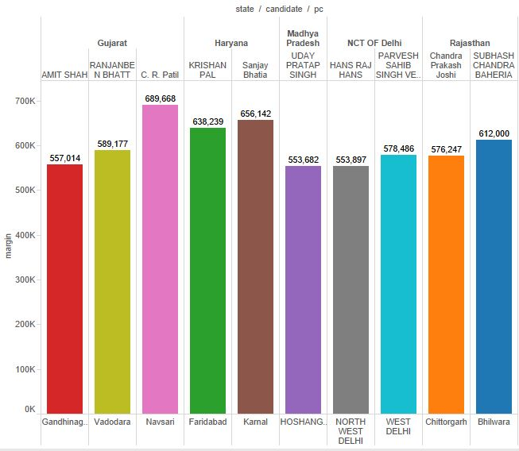
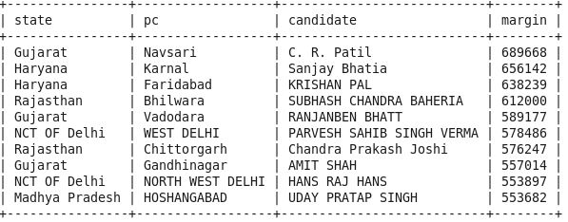
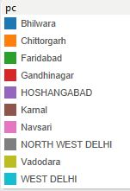
Q)Top 10 Win by highest margin

Slide 18
Q) Top 10 Win by lowest margin
create table m1 as select state,pc,candidate,total_vote from project where rank=1 order by state;
create table m2 as select state,pc,candidate,total_vote from project where rank=2 order by state;
select m1.state as state,m1.pc as pc,m1.candidate as candidate,(m1.total_vote-m2.total_vote) as margin from m1 join m2 on(m1.pc=m2.pc) order by margin limit 10;

Slide 19
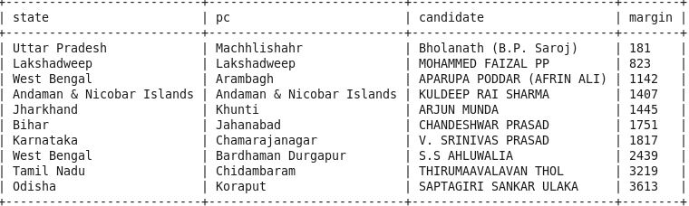
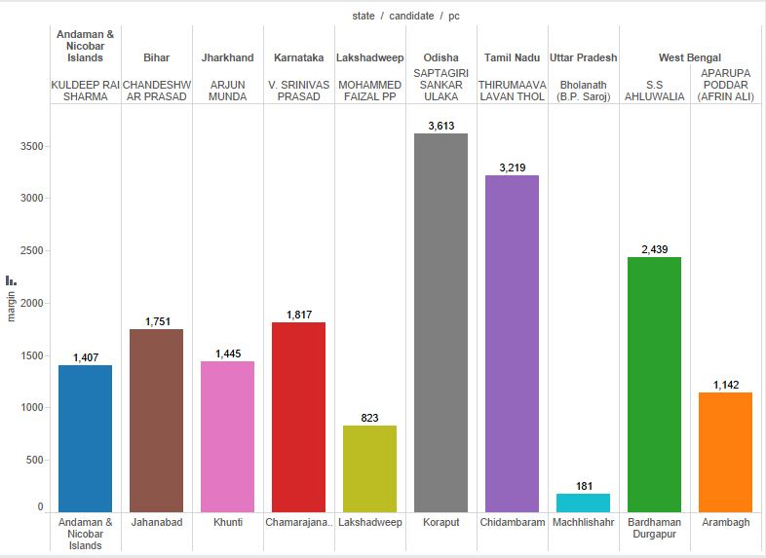
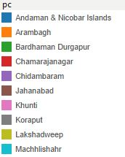
Q) Top 10 Win by lowest margin

Slide 20
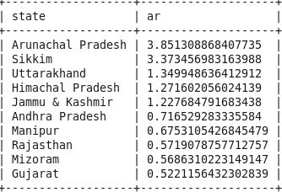
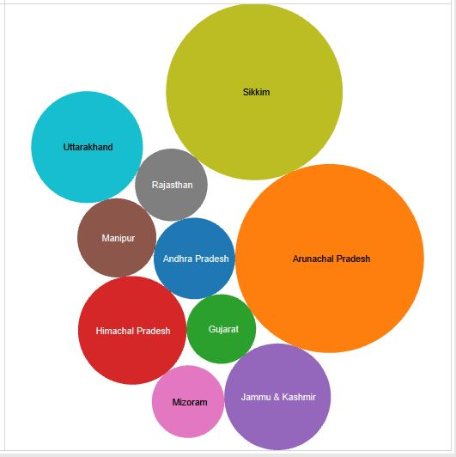
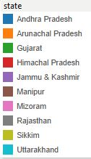
Q)Top 10 states to cast max number of postal votes
select state ,100*(sum(postal_vote)/sum(total_vote)) ar from project group by state order by ar desc limit 10;

Slide 21
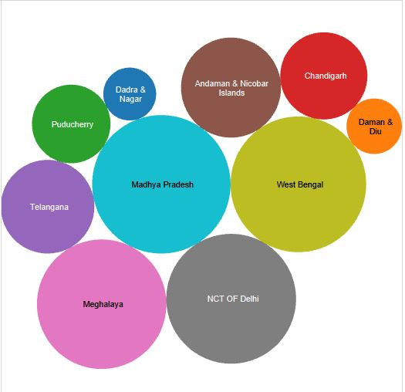
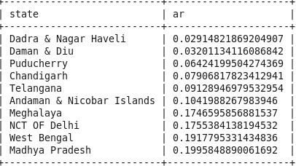
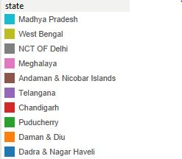
Q)Top 10 states to cast least number of postal votes
select state ,100*(sum(postal_vote)/sum(total_vote)) ar from project group by state order by ar limit 10;

Slide 22
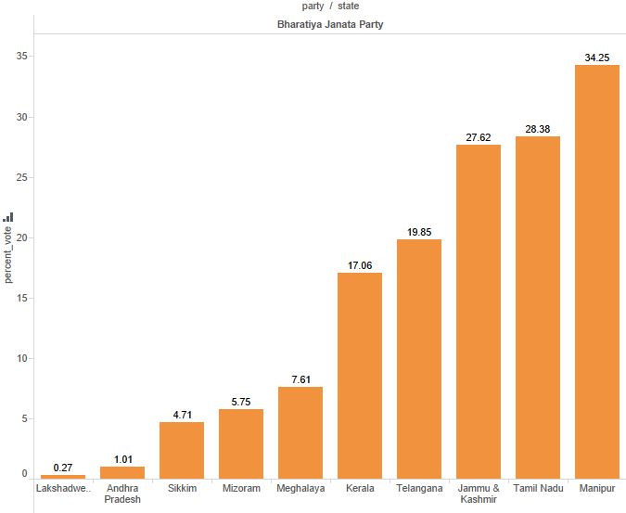
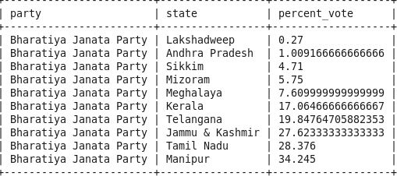
Q)Find top 10 states where there is least percentage vote shared by Bharatiya Janata Party
select party,state,avg(percent_vote) as percent_vote from project where party='Bharatiya Janata Party' group by party,state order by percent_vote limit 10;

Slide 23
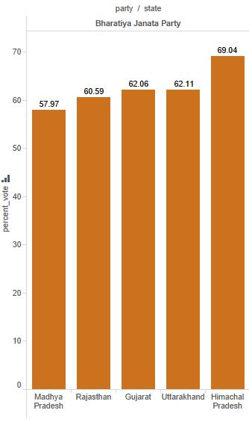
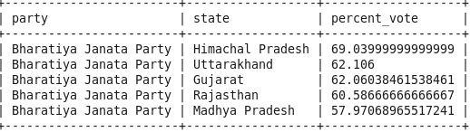
Q)Find top 10 states where there is maximum percentage vote shared by Bharatiya Janata Party
select party,state,avg(percent_vote) as percent_vote from project where party='Bharatiya Janata Party' group by party,state order by percent_vote desc limit 10;

Slide 24
Scope of the project:
The future scope of the project, i.e., the analysis of the Indian General Elections data set paves a path for further work that can be carried on to find and verifying the changed sentiments of the user before and after election. The study can be enhanced to actually classify the gender of the user and to match it with actual demographics it can include the scope for verifying whether the user is human or a robot. Other analysis suggests the count of votes received which helps in further enhancement of the system. With this project, we can also determine the statistics for the most popular party in the respective year and also focuses on analysis and report on specific details which would eventually help the census offer enhanced, accurate information that would incur several positive changes in the entire data analysis scenario.

Slide 25
THANK
YOU

